Slide 1
Standard Work

Slide 2

Other Modules In This Series:
5S
Standard Work
Total Productive Maintenance (TPM)
Administrative Lean
Cell Design/ Production Preparation Process (3P)
Kaizen
Kanban
Problem Solving
Poka Yoke Quality Systems
Transaction Process Improvement (TPI)
Cause & Effect Diagram with the Additions of Cards (CEDAC)
Single Minute Exchange of Dies (SMED)
Value Stream Mapping (VSMi®)
Visual Management
Managing Daily Process Excellence
For More Information Please Contact:
Mark DeLuzio, President and CEO
+1.860.234.0915
mark.deluzio@leanhorizons.com
Strategically Creating Value Through the Elimination of Waste

Slide 3
This document contains confidential
and proprietary information owned
by Lean Horizons Consulting, LLC.
Any disclosure, use, copying or
distribution of this information without the express written consent of Lean Horizons Consulting is strictly prohibited.

Slide 4
Ground Rules for Event
Safety first (use personal protective equipment)
Active participation by all
Start and end on time
All electronic gadgets (phones, pagers, etc) turned to “off” or “silent”
Computers to be used only when instructed
Keep an open mind to change
Don’t let “perfect” get in the way of “better”
Notes:
DO: Perform Group Introductions. Pick an ice-breaker or exercise to warm the team up to the event. (Icebreaker Example: Everyone uses their name tent and writes a “Personal License Plate” in which they have 2 minutes to creatively use a total of 7 letters or numbers to tell us something about themselves. Examples “LV2SAIL” OR “DADOV5”
DO: Review Event Ground Rules.
ASK: “Does anyone have any rules they would like to see added?”
ASK: “Does everyone agree to these?”

Slide 5
Goal of Standard Work Module
To define Standard Work and apply the Standard Work process and tools to achieve a target goal for your business.
Takt
Time vs.
Cycle Time
Work
Sequence
Standard
Work In
Process
(WIP)
Standard
Work
Documentation
Notes:
DO: Introduce the notion of Standard Work and the goal of this event.

Slide 6
Standard Work: Improvement Cannot Be Made Without a Standard
Toyota Production Model
Defines interaction between people and environment when processing products or services
Details motion of the operator and his work sequence
Provides a routine for consistency of an operation
Details best processes known and understood
Provides basis for improvement by defining the normal and highlighting the abnormal
Just In Time
Jidoka
Standard
Work
Heijunka
Kaizen
Notes:
SAY: “Standard Work is a foundational element of the Toyota Production System.”
DO: Explain the components of the TPS Model:
Just in Time: Delivering the right product with the right quantity and quality in at the exact time that it is needed.
Jidoka: Also called autonomation. The machine has the intelligence to detect a defect. This is considered more accurate than relying on manual inspection. Eliminates the production of rejects.
Heijunka: A Japanese work for level loading. The idea here is to reduce the variation of customer demand by leveling the production schedule.
Kaizen: Continuous improvement. Everything that we do today we can do better tomorrow.
Standard Work: Creates a baseline for improvement. Assures that work will be done in a consistent manner, thereby improving quality.

Slide 7
Standard Work Characteristics
Documented process; must be repetitive to apply Standard Work concepts
Separate focus on the operator, separate focus on the machine
Combined focus on the interaction of operator and machine
Is different than a traditional time and motion study:
  Takes customer demand into consideration
  Expects that the operator will perform multiple, repetitive operations within a work sequence
  Does not promote the building of unnecessary inventory
Notes:
SAY: “We just discussed the straight forward definition of standard work. There are subtleties that distinguish standard work. Note, the separate focus of the operator and of the machine. After the separate focus, there is a combined focus of the interaction between the operator and the machine. Standard work is not the same as traditional time and motion study. The differences include (TAKT time–customer demand, expects the operator to perform multiple repetitive operations within a work sequence and does not promote the building of unnecessary inventory).”

Slide 8
Standard Work Improves Productivity
Output
Input
P =
Standard Work impacts both sides of the equation
To improve productivity:
Output must go ___ at same input level
Input must go ____ at same output level
Notes:
SAY: “Productivity is equal to output over input. Improving productivity is an outcome of standard work. Standard work affects both the numerator and denominator.”

Slide 9
Value Added vs. Non-Value Added
Non-Value Adding Process
Value Adding Process
Those process steps that take time, resources, or space, but do not add value to the product or service
A process step that transforms or shapes a product or service which is eventually sold to a customer
Who is the customer?
Notes:
DO: Have the discussion around knowing who your various customers may be for a process. What might not be considered value-adding to one customer, may be considered value-adding to another.

Slide 10
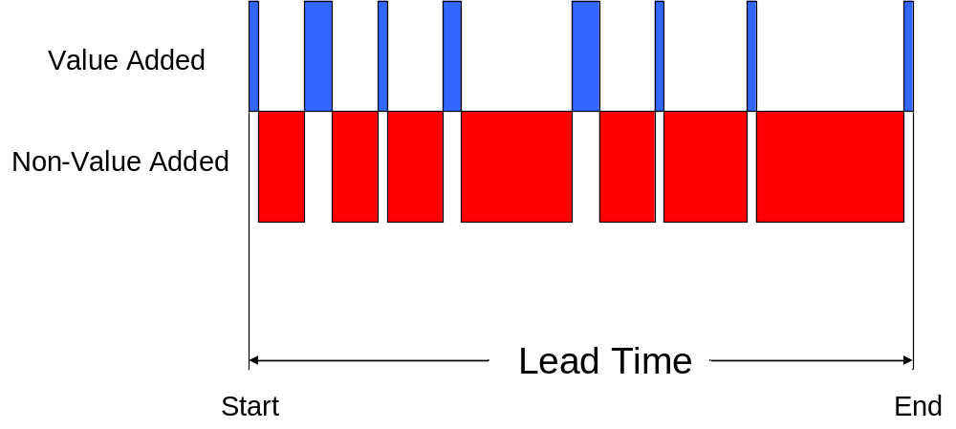
Value Added vs. Non-Value Added
XYZ Value Stream
Non-value added activity increases
Lead times
Adds cost
Creates opportunities for defects
Increases inventories
Inhibits Flow Production
Notes:
SAY: “In the previous slide, the definitions of Value Added (VA) and Non-Value Added (NVA) were introduced. This slide continues to help define the difference between VA and NVA, and helps provide a visual representation.”
SAY: “It is helpful to use a process as an example. One easy example is a machined part that goes through several operations that are VA; cut to size, turn, mill, drill, plate, polish, etc. Mention the 95/5 split, but it’s better to use an example that the audience experiences. Get the audience to tell you how long the VA steps take for one of their parts or products; 10 seconds to cut, 20 second to turn, etc. Then ask for the estimated lead time. Next, do the math to give the % split. Fabricated parts are normally much less than 5% VA.”

Slide 11
Value Added vs. Non-Value Added
Lean tools help identify and eliminate waste from our processes, leading to:
Reduced costs and lead time
Faster response
Improved quality
Reduced inventory and floor space
Better predictability
$
$
$
$
$
$
$
$
$
$
Waste
Waste
Lead Time
New
Lead Time
Notes:
SAY: “One point to make is that we are focusing on eliminating waste, not trying to improve value added steps.”
SAY: “Reducing Lead Time does all of these things and improves market share, sales and growth.”
ASK: “What does this do for the employee?” (removes repetitive tasks, improves quality of life)
SAY: “As waste is eliminated or reduced, lead time is reduced, cost is reduced, quality is improved by reducing the number of opportunities, and inventory is reduced. Predictability is improved, which reduces variation.”

Slide 12
Exercise: Standard Work Charter Review
Objective
Review the Standard Work Charter for the event against charter criteria
Instructions
Time to Complete
As a team review the event charter and answer the following questions:
What is the business need for this event?
Who is the owner?
What are the goals for this event?
30 minutes
Deliverable
Make any modifications
to charter as necessary.

Slide 13
TAKT Time vs. Cycle Time
Takt Time vs.
Cycle Time
Work
Sequence
Standard WIP
Documentation
Objectives:
Define “takt time” and identify origins
Calculate takt time
Differentiate cycle time from takt time
Identify types of cycle time
Calculate number of operators
Calculate cycle time
Notes:
DO: Review section objectives on slide.

Slide 14

Origin of Takt Time
TAKT Time vs. Cycle Time
Takt Time
Term first introduced in German industry as it embraced mass production in the 1930’s
Meaning a “precision interval of time”, as in musical meter
German aircraft firms moved fuselages ahead to workstations at intervals determined by TAKT time*
Has emerged in the English language in the last decade as lean thinking has spread
From Lean Thinking by James P. Womack and Daniel T. Jones
Notes:
REFERENCE FOR MORE ON ORIGINS OF TAKT TIME:
This term is an interesting example of a word moving from region to region until it is now becoming standard in German, Japanese, and English. The word itself, meaning a precision interval of time, as in musical meter, was first introduced in German industry as it embraced mass production in the 1930s. German aircraft firms moved aircraft fuselages ahead to the next workstation at steady intervals determined by the Takt time. Mitsubishi imported the term in its German form for its own aircraft production efforts in Japan and the term was later taken up by Toyota. It has only crept into English in the last decade as lean thinking has spread. For the historical details see Kazou Wada, "The Emergence of the 'Flow Production' Method in Japan," in Haruhito Shiomi and Kazuo Wada, Fordism Transformed: The Development of Production Methods in the Automobile Industry (Oxford: Oxford University Press, 1995.
Later research led to the information that the specific German production line in question was the one for the Junker airplane.
Source:
James P. Womack
and Daniel T. Jones,
Lean Thinking, 1996

Slide 15
TAKT Time
TAKT Time vs. Cycle Time
1
2
3
Definition
Calculation
Origin
How often you should produce one part, based on the rate of sales to meet customer requirements
Available Working Time (per shift)
Customer Demand (in units)
Expressed in seconds
German
Translated means a precision of musical meter
Takt time measures the “beat” of customer demand
Notes:
SAY: “TAKT time is defined as the rate at which you should produce one part based on the rate of sales to meet customer demand. TAKT time should be expressed in seconds and is calculated by (read the equation).”

Slide 16
TAKT Time Example
TAKT Time vs. Cycle Time
Takt Time Calculation
Gross available time
(8 hours x 3600 seconds) = 28,800 secs
Less breaks
(30 minutes x 60 seconds) = 1,800 secs
Available Time = 27,000 secs
Customer demand = 350 units
TAKT Time = 77 secs
.
Available Working Time
_____________________________
Customer Demand
27,000 seconds
= 77 seconds
350 units
Example
Customer Demand per Shift: 350 units
Hours per Shift: 8 hours
Lunch: unpaid
Breaks (2 – 15 minute) 30 minutes
Notes:
DO: Review the definition for TAKT time here and the exact calculation. Here is an example of a TAKT time calculation. The inputs are the customer demand is 350 units per shift, there are 8 hours per shift, an unpaid lunch and two 15 minute paid breaks. Start by calculating the gross available time which is 8 hours * 60 minutes per hour * 60 seconds per minute. Subtract from this total the breaks (30 minutes * 60 seconds per minute) for a total available time of 27,000 seconds. Note, in this case there is a paid lunch. To calculate the TAKT time, divide 27,000 seconds by 350 units to get 77 a TAKT time of 77 seconds.

Slide 17
TAKT Time Example
TAKT Time vs. Cycle Time
Takt Time Calculation
Available Working Time
_____________________________
Customer Demand
8
480
____ Hrs = _________ Minutes (Based on standard work shift)
- ________ Minutes (Break Time)
- ________ Minutes (Wash Time)
- ________ Minutes (Clean-up)
Total ______ Available Minutes per Shift
30
Customer Demand = 890 units
Example
450
________ Minutes Available x 60 = ________ Seconds per shift
________ Seconds Divided by _____ pcs/shift = _______ Seconds
TAKT Time = __________ Seconds
per Piece
450
890
Notes:
DO: Review the definition for TAKT time here and the exact calculation. Here is a simple template you can use to properly categorize the elements of TAKT time. Your actual calculation may be a little more difficult, but will follow the same fundamentals.
DO: Based on the amount provided on the slide, 890 units for daily demand, the TAKT Time equation would be:
450 min avail x 60 sec = 27,000 sec per shift
27,000 sec/890 units/shift = 31 seconds
TAKT Time = 31 seconds per piece (meaning the customer needs us to make one unit every 31 seconds)

Slide 18
Three Types of Cycle Time
TAKT Time vs. Cycle Time
1
2
3
Operator Cycle Time
Machine Cycle Time
Processing Cycle Time
The amount of time it takes an operator to complete one full cycle in his/her assigned work sequence
Defined as the amount of time it takes a machine to completely finish one full cycle (start/stop time)
The machine cycle time PLUS the manual time it takes an operator to unload, load, and cycle start the machine and amortized tool change time
Cycle Time is NOT to be confused with Takt Time
Notes:
DO: Review definitions on the slide and then speak specifically to each type on the following slides.

Slide 19
Operator Cycle Time Defined
TAKT Time vs. Cycle Time
Operator Cycle Time
The amount of time it takes an operator to complete one full cycle in his/her assigned work sequence
Example: It takes the first operator 60 seconds to perform operation 1-2-10-11 and return back to 1, ready to begin another cycle
11
10
9
8
7
6
1
2
3
4
5
Notes:
SAY: “The operator cycle time is the time it takes an operator to complete one full cycle in his/her assigned work sequence.”

Slide 20

Machine Cycle Time Defined
TAKT Time vs. Cycle Time
Traditional Batch Manufacturing
Defined as the amount of time it takes a machine to completely finish one full cycle (start/stop time)
Has nothing to do with the operator
GO
1. Hit Cycle Start
2. Machine Cycles
STOP
3. Machine Comes to Rest
Notes:
SAY: “In calculating machine cycle time remember that this has nothing to do with the operator. It is the time it takes a machine to completely finish one full cycle.”

Slide 21
Processing Cycle Time Defined
TAKT Time vs. Cycle Time
The machine cycle time PLUS the manual time it takes an operator to unload, load, and cycle start the machine and amortized tool change time
Amortized tool change is the time it takes to complete a scheduled tool change divided by the number of cycles between the tool change
Only for scheduled tool changes
OCT + MCT = PCT
Notes:
SAY: “The third type of cycle time to define is Processing Cycle time. The machine cycle time plus the manual time it takes the operator to unload, load and cycle start the machine and amortized tool change time. The amortized tool change is the time it takes to complete a scheduled tool change divided by the number of cycles between the tool change. The amortized tool change time is only for scheduled tool changes.”

Slide 22
Exercise: Cycle Time
TAKT Time vs. Cycle Time
Objective
Calculate types of cycle time.
Instructions
Time to Complete
Use the information on the following slide to calculate the following:
Total Operator Cycle Time
Processing Time for Machine #1
10 minutes
Deliverable
Discuss answers as a class
Notes:
ANSWERS: (post on a chart paper or whiteboard in the room)
Total Operator Cycle Time: Total operator cycle time is the sum of the time it takes to build the part at Station #1, to gauge the part, walk the part from Station #1 to Station #2, unload the part from Station #2 start machine #2 and ends with the time it takes to walk back to Station #1.
Unload, Load, Start #1: 10 sec
Gage part 12 sec
Walk 4 sec
Unload, Load, Start #2: 12 sec
Walk 3 sec
Total 41 sec
Processing Time for Machine #1: The processing time for machine #1 is the sum of the time to unload, load and start machine #1 plus the machine cycle time for machine #1.
Unload, Load, Start #1: 10 sec
Machine Cycle Time 25 sec
Total 35 sec

Slide 23
Exercise: Cycle Time
TAKT Time vs. Cycle Time
Operator cycle time for unloading, loading (raw material), and cycle starting machine #1 is 10 seconds
Machine #1 cycle time is 25 seconds
Operator gages the part after the unload, which takes 12 seconds
Operator takes 4 seconds to walk with part to machine #2
Operator cycle time for unloading, loading, and cycle starting machine #2 is 12 seconds
Operator returns to machine #1 with a walk time of 3 seconds
Notes:
NOTE: The information on this slide corresponds to the exercise on the previous slide.

Slide 24
Exercise: Takt Time
TAKT Time vs. Process Time
Objective
Use takt time and cycle time to make decisions.
Instructions
Time to Complete
In pairs, read and answer the following.
Consider the following data:
Your bottleneck machine in a cell has a cycle time of 150 seconds.
The takt time for the cell is 120 seconds (one
shift operation)
What are your options? What would you do?
10 minutes
Deliverable
Discuss answers as a class
Notes:
DO: First have the class work in pairs to answer the question. Call on people for the answers. Discuss.
ANSWERS: Some options: Work overtime, kaizen the process to understand the cycle time of the bottleneck machine, work additional shifts
NOTE: The term “bottleneck” refers to the process/machine where processing time is greater than TAKT time. When flow is in place, each process must be able to product to TAKT time or less in order to meet customer demand.

Slide 25
Work Sequence
Takt Time vs.
Cycle Time
Work
Sequence
Standard WIP
Documentation
Objectives:
Define “work sequence”
Differentiate Operator Flow vs. Part Flow
Determine work sequence
Calculating number of operators
Notes:
DO: Review objectives of the section.

Slide 26
Work Sequence Defined
Work Sequence
The specific order in which an operator performs the manual steps of a process for
one part
Example: Operations
1-2-10-11 and back to 1 is one work sequence
11
10
9
8
7
6
1
2
3
4
5
Notes:
SAY: “Work sequence is defined as the specific order in which an operator performs the manual steps of a process for one part.”

Slide 27
Work Sequence
Work Sequence
Operator Flow vs. Part Flow
R
Operator and part follow the same sequence
5
4
3
2
1
6
7
8
9
10
F
Notes:
SAY: “In this case, the operator and part follow the same sequence.”

Slide 28
Work Sequence
Work Sequence
Operator Flow vs. Part Flow
4
3
2
1
R
Operator does not flow the same as the part
2
1
3
2
1
3
4
4
5
6
5
6
7
8
F
Notes:
SAY: “Here is another work sequence combination where the operators do not flow the same as the part. Note, Operator #1 retrieves the raw material completes steps 1,2 7,8 and deposits the finished product into the finished goods container. Operator #2 completes steps 3,4 5 & 6 in this work sequence.”

Slide 29
Exercise: Work Sequence
Work Sequence
Objective
Demonstrate understanding of work sequence.
Instructions
Time to Complete
As a class, discuss the answers to the following:
Should operator flow always follow part flow?
  Why?
  Why not?
10 minutes
Deliverable
Discuss answers as a
class
Notes:
ANSWER: "No". In order to support the least operator concept we frequently use U shaped cells. When we do that one or more operators frequently are doing steps that are not in part sequence. Example - operator 1 does part sequence 1 and 6. Although each operator is not flowing with the part together – the process and sequence is designed for continuous flow.”

Slide 30
Determining Total Number of Operators Needed
Work Sequence
Points Descriptions
1
Calculation for
Total # of Operators
Sum of the Total Operator Cycle Times
Takt Time
2
Example
Total Cycle Time = 270 seconds
Takt Time = 77 seconds
Total Number of Operators Needed = 3.5 Operators
3
Question
How do you staff for 3.5 Operators?
Notes:
SAY: “To determine the number of operators needed, sum the total operator cycle times and divide by the TAKT time. This result is the number of operators required to produce at TAKT time.”

Slide 31
Partial Operator—Guidelines
Work Sequence
Remainder in # of operators | Guideline
<.3 | Do not add another operator. Look for waste and kaizen opportunities to eliminate this work.
.3 - .5 | Do not add another operator yet. Run area for two weeks and evaluate if enough waste exists to reduce the operator cycle time.
>.5 | Add another operator if necessary and continue to reduce waste and operator cycle time which will eventually eliminate the need for this operator.
Notes:
SAY: “In most cases, when the number of operators needed is calculated, the result will not be a whole number. The recommended staffing based on the calculation is: (read chart). In the early stages this guideline can be very helpful. Many times people, in their zest to make change, will remove any and all fractional heads. Recommendation is to not fall into that trap. This will help ensure a high probability of success.”

Slide 32
Exercise: Putting it all together
Work Sequence
Objective
Calculate the takt time, number of operators, and determine the best
work sequence for each operator.
Instructions
Time to Complete
In small groups, calculate takt time, number of operators, and determine the work sequence for each of the examples on the following three slides.
15 minutes
Deliverable
For each example,
determine takt time,
number of operators,
and work sequence
Notes:
SAY: “We will now do some exercises to demonstrate the interaction between TAKT time, number of Operators and work sequence for each operator. Remember to pick up raw material (RM) and place the finished good (FG) into the finished good container.”

Slide 33
Exercise
Work Sequence
Daily Demand: 270 pieces
Available Time: 450 minutes
Takt Time: _________________
Number of Operators: _______
Draw the work sequence for each operator:
5s
5s
22s
22s
10s
10s
25s
25s
RM
RM
4
4
3
3
2
5
2
5
1
1
10
8
10
6
8
6
7
7
9
9
FG
FG
8s
8s
15s
15s
5s
5s
10s
10s
Notes:
ANSWERS:
Takt Time = 100 seconds
Number of Operators = 1

Slide 34
Exercise
Work Sequence
Daily Demand: 540 pieces
Available Time: 450 minutes
Takt Time: _________________
Number of Operators: _______
Draw the work sequence for each operator:
5s
5s
22s
22s
10s
10s
25s
25s
RM
RM
4
4
3
3
2
5
2
5
1
1
10
8
10
6
8
6
7
7
9
9
FG
FG
8s
8s
15s
15s
5s
5s
10s
10s
Notes:
ANSWERS:
Takt Time = 50 seconds
Number of Operators = 2

Slide 35
Exercise
Work Sequence
Daily Demand: 1080 pieces
Available Time: 450 minutes
Takt Time: _________________
Number of Operators: _______
Draw the work sequence for each operator:
5s
5s
22s
22s
10s
10s
25s
25s
RM
RM
4
4
3
3
2
5
2
5
1
1
10
8
10
6
8
6
7
7
9
9
FG
FG
8s
8s
15s
15s
5s
5s
10s
10s
Notes:
ANSWERS:
Takt Time = 25 seconds
Number of Operators = 4

Slide 36
Standard Work In Process (WIP)
Takt Time vs.
Cycle Time
Work
Sequence
Standard WIP
Documentation
Objectives:
Define Standard Work in Process (WIP)
Define Curtain Effect
Calculate Standard WIP and Curtain Quantities
Notes:
DO: Review objectives of the section.

Slide 37
Standard WIP
Standard WIP
Points Descriptions
Minimum amount of parts on the line that will allow the operator to flow product efficiently
Any time the cycle time of a process or the lead time of an external process is longer than TAKT time inventory is needed in the form of Standard WIP
1
Standard Work
In Process
(WIP)
2
Standard WIP
Calculation
Cycle Time
Takt Time
Notes:
SAY: “A common term used in standard work is Standard Work-in-Process. The common abbreviations are WIP or SWIP. Standard WIP is defined as the amount of parts required on the line that will allow the operator to flow product efficiently.”

Slide 38
Standard WIP
Standard WIP
2
3
1
FG
RM
Standard WIP = 9
Machine #1 (Single Spindle)
Machine #2 (Multi-station Machine)
Machine #3 (Single Spindle with no Standard WIP)
Notes:
SAY: “For this cell the Standard WIP is nine pieces. This is an example of what Standard WIP looks like in a cell.
RM = Raw Materials
FG = Finished Goods

Slide 39
Exercise: Standard WIP
Standard WIP
Objective
Demonstrate understanding of Standard WIP.
Instructions
Time to Complete
Use the example on the following slides to determine the following:
TAKT Time
2. SWIP (Potting – Station 4)
3. SWIP (RTV – Station 7)
10 minutes
Deliverable
Discuss answers as a class
Notes:
NOTE: Use the following three slides for this exercise.
DO: Use this example to reinforce SWIP and Curtain Quantity and to show the difference between the two. It is also a review of TAKT Time and Work Sequence.
1. Have the class calculate TAKT Time.
TT = Available Time/daily demand
TT = 450 min/7 units/day = 64.3 min
TT = 64.3 min
2. Walk through the operations in the cell. Go step by step through the calculation for SWIP at Station 4 and give them the answer.
SWIP = cycle time/TT
SWIP = 21 hours/64.3 min (convert hours to minutes)
SWIP = 1260/64.3 min
SWIP = 19.59 ( or round up to 20 units)
3. Ask the class to calculate SWIP at Station 7.
SWIP = (10 hrs x 60 min) / 64.3 min
SWIP = 600/64.3
SWIP = 9.3 rounded up to 10

Slide 40
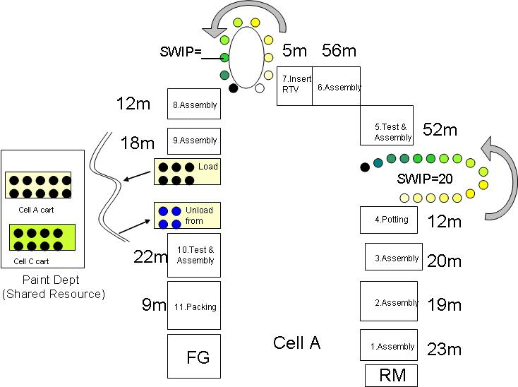
Exercise: Standard WIP
Standard WIP
Daily Demand = 7 units
Available Time = 450 min
Potting curing = 21 hours
RTV curing time = 10 hours
LT for Paint = 24 hours
Sum of Operator Cycle Times = 248 min

Slide 41
Exercise: Description of Cell Operations, Stations 1-6
Standard WIP
Station 1: Operator starts with raw material and performs assembly work
Station 2: Operator builds a sub-assembly and inserts it into product
Station 3: Operator builds a sub-assembly and inserts it into product
Station 4: Operator inserts circuit board, adds potting compound and puts product on carousel, indexing the carousel by one position.
Station 5: Operator removes product from carousel and tests functionality
Station 6: Assembly work
Notes:
NOTE: For use with exercise

Slide 42
Exercise: Description of Cell Operations, Stations 7-11
Standard WIP
Station 7: Operator installs an RTV Silicon and hangs the product on the carousel, indexing the carousel by one position.
Station 8: Operator removes product from carousel and does some assembly work
Station 9: Operator does assembly work and puts product on the cart to be painted
Station 10: Operator removes painted product from cart, tests functionality and does some assembly work
Station 11: Operator packages the product and places package on Finished Goods cart
Notes:
NOTE: For use with exercise

Slide 43
Curtain Quantity Calculation
Standard WIP
Points Descriptions
1
Curtain Effect
The result of an outside process needed to facilitate the cell operation
2
Curtain Quantity
Calculation
Lead Time of Process
TAKT Time
= # of pieces in a curtain
3
Example
Total Lead Time = 20 minutes
TAKT Time = 77 seconds
Curtain Quantity = 15.6 or 16 pieces (always round up)
4
Important Note
Curtain Quantity must be doubled if FIFO (first-in first-out) is not possible
Notes:
SAY: “The curtain effect is a result of an outside process needed to facilitate the cell operation.”
SAY: “The equation for calculating the curtain quantity is the number of pieces in the curtain are the lead-time of a process over the TAKT time. When calculating the number of pieces in a curtain always round up when there is a remainder. When FIFO is not possible, the curtain quantity must be doubled.”

Slide 44
Standard WIP with Curtain Effect
Standard WIP
Standard WIP
Standard WIP w/Curtain Effect
Machine #1 (Single Spindle)
Machine #2 (Multi-station Machine)
Machine #3 (Single Spindle with no Standard WIP)
Machine #1 (Single Spindle)
Machine #2 (Monument)
Machine #3 (Multi-station Machine)
2
2
3
3
1
1
4
FG
RM
FG
RM
Standard WIP = 9
Standard WIP = 13
Notes:
SAY: “For this cell the Standard WIP is nine pieces.”
SAY: “Another aspect of Standard WIP is Standard WIP with curtain effect. The curtain effect is a result of an outside process needed to facilitate the cell operation. In this case, In this example, the parts leave the cell after station #1. The operations performed at step #2 are done outside the cell, Parts are reintroduced prior to station #3. These pieces of inventory represent the curtain effect. The abbreviation used for curtain quantity is CQ.”
RM = Raw Materials
FG = Finished Goods

Slide 45
Exercise: Standard WIP and Curtain Quantities
Standard WIP
Objective
Demonstrate understanding of Standard WIP and Curtain Quantity calculations.
Instructions
Time to Complete
Use the example for previous exercise to determine the following:
Curtain Quantity
# of Operators
Draw Operator Work Sequence
10 minutes
Deliverable
Discuss answers as a class
Notes:
NOTE: For use with exercise
4. Ask the class to calculate the Curtain Quantity for Paint. Point out that for CQ, it is important to use the Lead Time, not just the Cycle Time of the curtain process.
CQ = LT/TT
CQ = (24 hrs. x 60 min)/64.3 min
CQ = 22.39 rounded up to 23
5. Ask the class to determine the number of operators needed and what the work sequence would be.
# of Operators: Total Operator Cycle Times/TT
# of Operators: 248 min/64.3 min
# of Operators: 3.85 rounded up to 4 operators
6. Recommended operator sequence (TT = 64.3 min):
Operator A: Process 1,2,3 (total of 62 minutes)
Operator B: Processes 4,5 (total of 64 minutes)
Operator C: Processes 6,7 (total of 61 minutes)
Operator D: Processes 8,9,10,11 (total of 61 minutes)

Slide 46
Standard Work Documentation
Takt Time vs.
Cycle Time
Work
Sequence
Standard WIP
Documentation
Objectives:
Identify components and use of the Standard Work Documentation:
  Time Observation Form
  Process Capacity Sheet
  Standard Work Combination Sheet
  Standard Work Sheet
  Operator Loading Chart
Define purpose of Standard Work Playbook
Review Document logistics
Identify components of the Kaizen Results Form
Notes:
DO: Review objectives of the section.

Slide 47
Standard Work Documentation Forms are Management Tools
Standard Work Documentation
Time Observation Form
Process Capacity Form
Standard Work Combination Sheet
Standard Work Sheet
Operator Loading Chart
Notes:
SAY: “There are five forms used for documenting standard work: Time Observation Form, Process Capacity Form, Standard Work Combination Sheet, Standard Work Sheet and the Operator Loading Chart. We will now review the contents of each of these forms.”

Slide 48
Time Observation Form
Standard Work Documentation
Used to document cycle time of an operator and his/her complete work sequence
7-10 observations typically taken
Lowest observable cycle used
Key input to Standard Work Combination Sheet
Notes:
SAY: “The first form is the Time Observation Form. It is used to document the cycle time of the operator. The expectation is you can monitor the operator for 7–10 cycles of the operator executing a task. You will record the lowest observable task time as the observed time to complete a task. This assumes you do find abnormalities during the observation. An abnormality may be something like the operator misses a step and is then able to have an observable time well below the other observable times. The Time Observation form is a key input to the Standard Work Combination Sheet.”
NOTE: “The reason we take the lowest observable time and not the lowest “repeatable task time” is because Standard Work is a tool used for improvement. If the operators were observed being able to do a task at a certain time (barring any abnormalities that would discount the observation), then that time should be used as the benchmark to strive towards. Standard Work is a tool used for improvement, not documentation.”

Slide 49
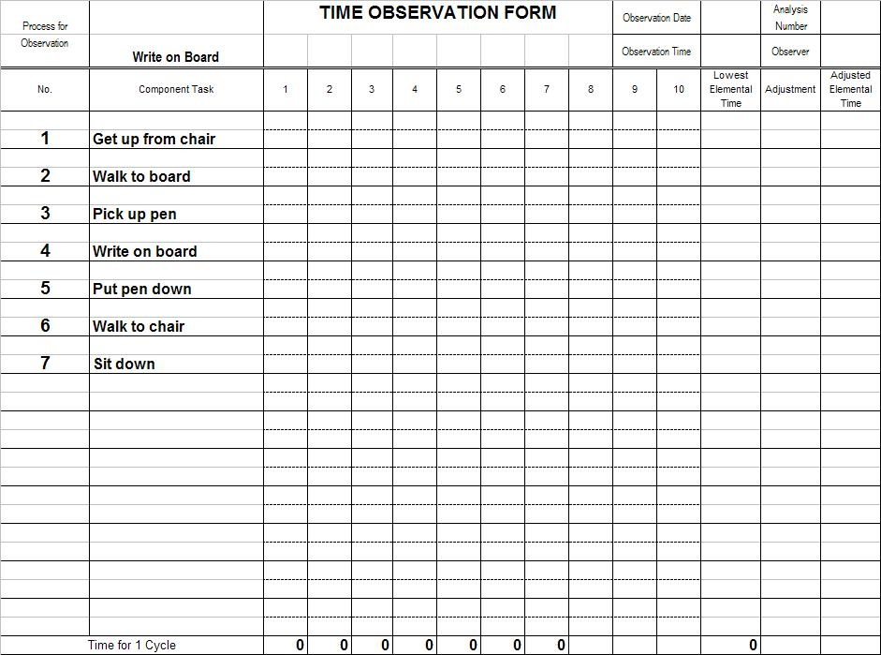
Time Observation Form
Standard Work Documentation
Step 1: List the process sequence.
Notes:
SAY: “The first step in completing the time observation form is to record the process step in sequence.”

Slide 50
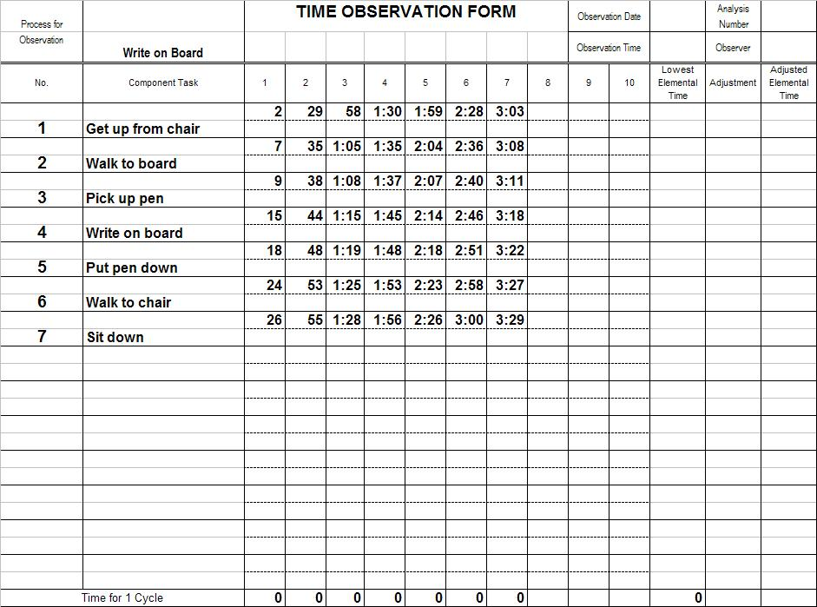
Time Observation Form
Standard Work Documentation
Step 2: Record time with a running stopwatch
Notes:
SAY: “Then, using a running stopwatch, record the time when each task is completed. If you miss one time, keep going.”

Slide 51
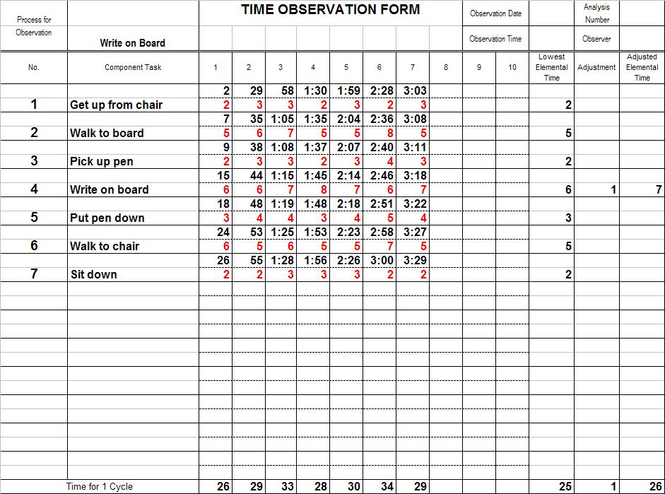
Time Observation Form
Standard Work Documentation
Step 3: Do calculations.
Notes:
SAY: “Now, place the lowest observable time to complete each process step into the column “Lowest Elemental Time.” Then add those times in that “Lowest Elemental Time” column and post the sum in the bottom row of that column (in our case 25 secs). Look at the bottom row labeled “Time for 1 Cycle”, find the shortest cycle and post that number in bottom row of the column labeled “Adjusted elemental time”. Compare the sum of the lowest elemental times to the lowest “Time for 1 Cycle”. If the sum in the “Lowest Elemental Time” column is less than the lowest “Time for 1 Cycle”, post the difference in the last row of the column labeled “Adjustment”. Also, post that number in the “Adjustment” column next to the larger* elemental time(s). Then post the total of each Lowest Elemental Time and its Adjustment in the “Adjusted Elemental Time” column and assure that the actual sum of Adjusted Elemental Times matches the number we posted in the last row of the “Adjusted Elemental Time” column.
* We do it to the larger since the % effect is the smallest there.”

Slide 52
Time Observation Tips
Standard Work Documentation
One form per operator
Let operators do the time observation
If you miss a time, keep going – don’t stop
Make sure your observation points are logical
Note any areas for kaizen as you are taking times
Note abnormalities
Notes:
SAY: “The Time Observation sheet needs to be completed for each operator in the cell. Don’t hesitate to allow the Operator to observe other Operators doing the task. Though it is noble for you to try to perform the tasks, do so at a different time; unless you maintain current certification for the task, do not use your time in the time observations. Keep the stopwatch running so if you miss a time you can keep going. Have logical observation points for each process step. It is okay to note ideas for kaizen on your sheet, they will be discussed later. Note abnormalities spotted during the observation.”

Slide 53
Process Capacity Sheet
Standard Work Documentation
Used to calculate the capacity of all equipment
Uses Processing Cycle Time
Highlights processes that are bottlenecks (where Processing Cycle Time > TAKT Time)
Proactive tool – allows for “what-if?” scenarios
One sheet per cell
Equation:
Operating time per shift
Total time to complete
Notes:
SAY: “The Processing Cycle time is used in the calculation. The Process Capacity Sheet is used to calculate the capacity for each piece of equipment in the cell. The process capacity sheet highlights the bottleneck processes, where bottleneck is defined as Processing Cycle Time is greater than the TAKT time. One cell is completed per cell and is a proactive tool allowing the ability to perform what-if scenarios.”
NOTE: Bottlenecks are defined as processes where processing time is greater than TAKT time.

Slide 54
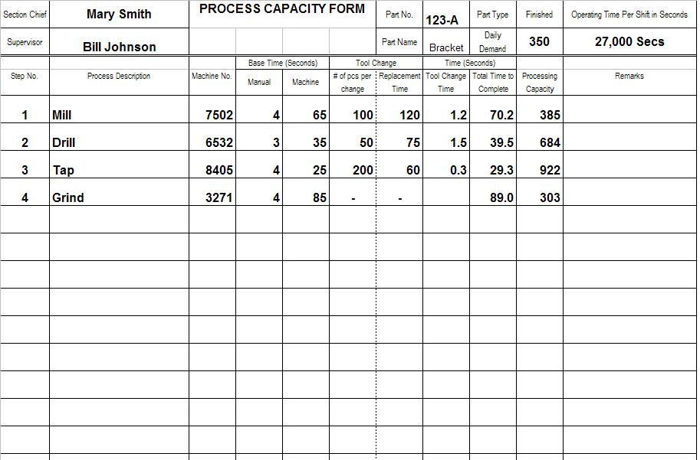
Process Capacity Sheet
Standard Work Documentation
Capacity Problem
Notes:
SAY: “Here is an example of a Process Capacity sheet. Note the potential capacity problem as the Grind Process has a capacity of 303 pieces but the daily demand is 350 units. Therefore the Grind process is a potential bottleneck.”
Assume plant is operating one shift. Processing Capacity is then “Operating Time per Shift” divided by “Total Time to Complete”. As an example, for Grind:
27000 secs/89 secs = 303 units.

Slide 55
Standard Work Combination Sheet
Standard Work Documentation
Graphically “combines” the interaction of the operator and equipment
Provides for a repeatable standard to follow
Compares relative cycle times with TAKT Times
Used to identify areas for improvement
Notes:
SAY: “The Standard Work Combination Sheet is the graphical representation of the interaction between the operator and the equipment. The Standard Work Combination Sheet provides the repeatable standard for the operators to follow. There is a comparison relative between the cycle times and the TAKT time, and it provides an opportunity to identify areas for improvement.”

Slide 56
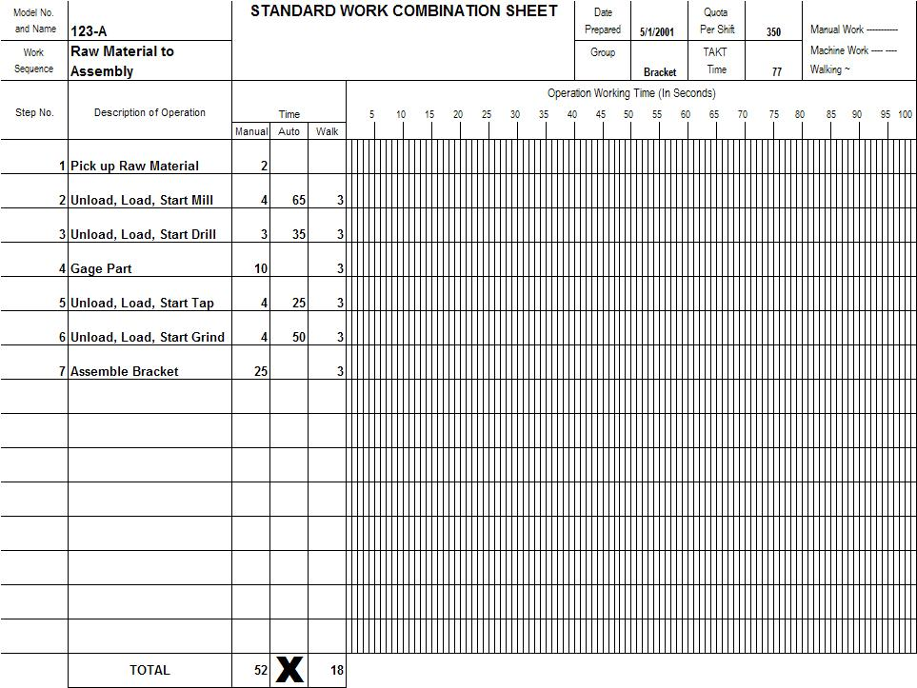
Standard Work Combination Sheet
Standard Work Documentation
Notes:
SAY: “The Standard Work Combination Sheet looks like this. The first operation is to pick the raw material (2 seconds of manual time), then, operation #2 is to unload and start the mill. In this step, there are 4 seconds of manual time, 65 seconds of automatic time and three seconds of walk time to get to the third station. TAKT time is shown on the work combination sheet is shown in red. In this case the operator can complete all tasks in 70 seconds, the TAKT time is 77 seconds. In this case, the operator can complete all tasks in less than the TAKT time.”

Slide 57
Standard Work Combination Tips
Standard Work Documentation
One sheet per operator
Post at the operator’s workstation
Create “playbook” with various TAKT Times
Always date your documentation
Combination Sheets do not replace more detailed work instructions
Use Combo Sheets to highlight kaizen opportunities
Always draw TAKT Time in red
Notes:
SAY: “Here are some tips for Standard Work Combination sheets. Use one sheet per operator and post the sheet at the operator’s work station. Create playbooks for the various TAKT times at which you plan to operate the cells. Always date your document. Work Combination Sheets do not replace more detailed work instructions. As is the case with many of the Lean tools, use the combination sheets to highlight kaizen opportunities.”

Slide 58
Standard Work Playbook
Standard Work Documentation
Each Demand level has a “Play”
For each Play:
  Operator Loading Chart
  Standard Work Combination Sheets
  Standard Work Sheets
  Daily Production Goals
FG
RM
Standard Work Sheet
T T
αβδδϕδϕ ϖνϖμ
αβδδϕδϕ ϖνϖμ
αβδδϕδϕ ϖνϖμ
αβδδϕδϕ ϖνϖμ
αβδδϕδϕ ϖνϖμ
αβδδϕδϕ ϖνϖμ
TT
Notes:
SAY: “For each demand level, represented by the different TAKT times, the Standard Work Sheets represent a ‘play.’ For each play, there are sets of operator loading charts, Standard Work Combination Sheets, Standard Work Sheets and daily production goals.”

Slide 59
Standard Work Sheet
Standard Work Documentation
Details the work sequence of an operator visually
Shows the operator’s work sequence in respect to the physical work area
Highlights Standard WIP requirements, gage, and safety precautions
Useful in visually detailing operator assignments
Also used as an audit tool for supervisors
Helpful when new operators are assigned to the work area
Notes:
SAY: “The Standard Work Sheet visually details the work sequence of an operator and shows the operator’s work sequence with respect to the physical work area. The Standard Work Sheet shows the Standard WIP requirements, gauge and safety conditions. These are useful in visually detailing operator assignments and are an audit tool that should be used by supervisors. The Standard Work Sheet is also the tool to use to help train new operators assigned to an area.”

Slide 60
Standard Work Sheet
Standard Work Documentation
Operation
From:
Raw Material
STANDARD WORK SHEET
Part No.
123-A
Sequence
To:
Assembly
Part Name:
Bracket
Tap
Drill
Mill
Raw
Material
+
+
+
Grind
5
4
3
2
1
6
+
7
Finished
Goods
Assembly
Test
Pack
Quality Check
Safety Precaution
Standard WIP
# Pieces WIP
TAKT Time
Cycle Time
+
4
77”
70”
Notes:
SAY: “This chart highlights the Standard Work Sheet. Note the identification of the SWIP, key safety locations and sequence of the operator.”

Slide 61
Operator Loading Chart
Standard Work Documentation
Details the cycle time for all operators in a cell
Compares operator cycle times to TAKT time
Allows supervisor to understand manning requirements at a glance
Facilitates the kaizen opportunities that may exist in a cell
Incorporates “Least Operator” concept
Notes:
SAY: “The next Standard Work document is the Operator Loading Chart. In this chart the cycle time for all operators in a cell is detailed. It compares the operator cycle times to TAKT time. It allows the supervisor to understand manning requirements at a glance. The Operator Loading Chart facilitates kaizen opportunities that may exist and incorporates the least operator concept.”

Slide 62
Operator Loading Chart
Standard Work Documentation
TAKT Time
A
B
C
D
E
Natural
TAKT Time
A
B
C
D
E
Traditional
TAKT Time
"Least Operator"
A
B
C
D
E
Front Loaded
Notes:
SAY: “This page should help understand Operator Loading Charts. The first graph shows the operator loads and the TAKT time. Note how operations A and C exceed TAKT time. Operator A & C are items that should be addressed in kaizen activities. In the second chart, we show the traditional picture of the Operator Loading Chart as compared to TAKT time. In this case, each operator is equally loaded and is less than the TAKT time. In the least operator method the operators are loaded to TAKT time and the amount of work remaining is given to the least operator. An advantage here is that the supervisor can tell how much improvement needs to be made to reduce an operator. Instead of trying to spread the savings across all operators, a better visual is available when displayed in this manner.”

Slide 63
Document Logistics
Standard Work Documentation
Document Name | On File | Work Station | Mouth of Cell
Time Observation | l
Process Capacity |  |  | l
SW Combination |  | l
SW Sheet (Layout) |  | l
Operator Loading |  |  | l
Notes:
SAY: “There are many documents generated when implementing Standard Work. Each document has a specific location in which it is kept. The Time Observation Form is saved on file, while the Standard Work Combination Sheet and Standard Work Sheet are kept at the work station. At the mouth of the cell you keep the Process Capacity Form and the Operator Loading Chart.”

Slide 64
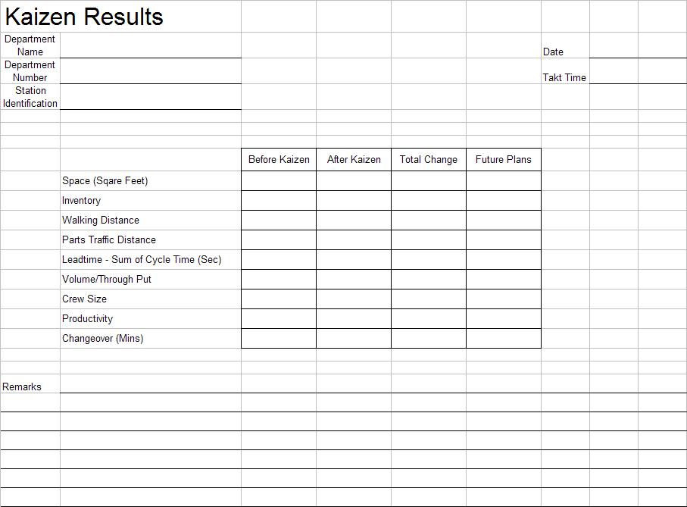
Kaizen Results
Standard Work Documentation
Notes:
SAY: “Here is a form we recommend you use to track the kaizen results. This makes it easier to have a visual of the improvements made to date and the opportunities that still exist.”
NOTE: This form is in excel and additional measurements could be added per the event objectives.

Slide 65
Prepare for Final Report-Out to Management
Standard Work Documentation
All team members should contribute to the final report-out presentation to management
Report-out should include
  Introduction of Team
  Review of Event Charter
  Review of Former Process and Documentation Forms
  Review of Improvement Opportunities Identified and Implemented
  Review of Standard Work Documentation and Kaizen Results Form
  Review of Kaizen Newspaper
Typical Report-Out times are 15 minutes for presentation and 15 minutes for questions
Notes:
DO: Cover report-out guidelines.

Slide 66
Review Exercise
2 Minute Review
In pairs, or in small groups, spend 2 minutes discussing key learnings and take-aways from this Standard Work Event thus far
One person from each group will share one learning that was discussed with the rest of the class

Slide 67
Standard Work Summary
Quality products produced at TAKT time
Productive utilization of people
  Operators should operate
  High operator productivity through loading to TAKT time
  Designed for minimum and maximum manning
Continuous flow of material and operators
  Workstation optimized for presentation of parts, materials, and tools; design supports continuous operator movement but minimizes wasted motion
Immediate flow information/feedback
Expose problems
Notes:
SAY: “In reviewing flow-manufacturing concepts, note how there are quality products produced at TAKT time. Flow-manufacturing supports improved utilization of people through higher productivity and proper staffing by design. It also enables the continuous flow of material and operators and provides immediate feedback, flow information, and exposes problems to the organization.”

Slide 68
Standard Work Summary
If a process is not documented, there is no process
Consistency in operations = improved quality
Without a standard, there can be no consistent improvement
Standard Work is dynamic, not stagnant
Standard Work is a management tool
Do not use Standard Work to lay off operators
If Standard Work is >30 days old, ask questions
  Has demand changed?
  Have improvements been made?
Notes:
SAY: “In closing, if a process is not documented, there is no process. The more consistent the operations, the better the quality. Without a standard, there can be no improvement. Standard Work is a dynamic tool used by management and should not be used to “justify” laying off operators. Standard Work should be no older than 30 days.”

Slide 69
Standard Work Summary
“If you don’t understand Standard Work, you don’t understand the Toyota Production System.”
Senji Niwa (1989) Shingijutsu Co., Ltd.
Notes:
SAY: “This is a strong statement.”
SAY: The founders of Shingijutsu Consultants have direct ties/lineage to Taichi Ohno and the Toyota Production System. Mr. Niwa was one of the original partners. What do you think he meant by this statement?
SAY: “Standard Work is a foundational element of the Toyota Production System. A lack of understanding of these concepts translates into a poor understanding of the Toyota Production System.”

Slide 70
Other Modules In This Series:
5S
Standard Work
Total Productive Maintenance (TPM)
Administrative Lean
Cell Design/ Production Preparation Process (3P)
Kaizen
Kanban
Problem Solving
Poka Yoke Quality Systems
Transaction Process Improvement (TPI)
Cause & Effect Diagram with the Additions of Cards (CEDAC)
Single Minute Exchange of Dies (SMED)
Value Stream Mapping (VSMi®)
Visual Management
Managing Daily Process Excellence
For More Information Please Contact:
Mark DeLuzio, President and CEO
+1.860.234.0915
mark.deluzio@leanhorizons.com
Strategically Creating Value Through the Elimination of Waste

